Slide 1
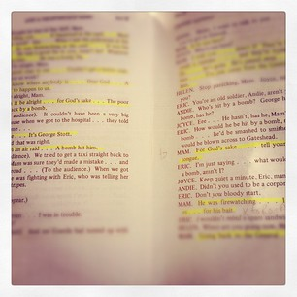
Drama: The 5 Elements of Plot
Behavior: Students will discover the concepts behind the 5 essential elements of plot structure. NJCCCS 1.1.5.C.1
Conditions: Students will participate in devising stories in "plot structure performance groups". NJCCCS 1.1.8.C.1
Criteria: After participating in students group performances, 80% of students will be able to identify at least 3/5 of the elements of plot structure.

Slide 2
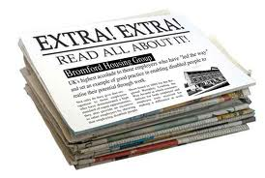
Take out your Plot Structure Homework!
With your Partner, take turns discussing your Fantasy Story!
Who are the Character?
What is the big change? The Ending?
October 7th, 2013
Do Now! Do Now!

Slide 3
DO NOW DO NOW DO NOW
Take out your Greek Myth Packet
    I will check your completed homework.
Take a seat in the Circle.
Be ready to present a short summary of your Original Greek Myth.

Slide 4
Identifying the Elements of A Plot Diagram
Student Notes

Slide 5
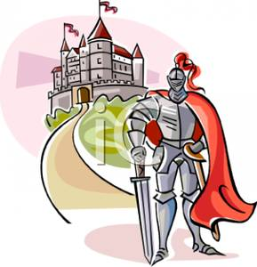
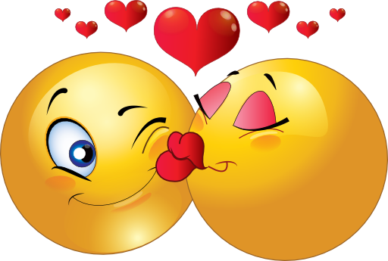
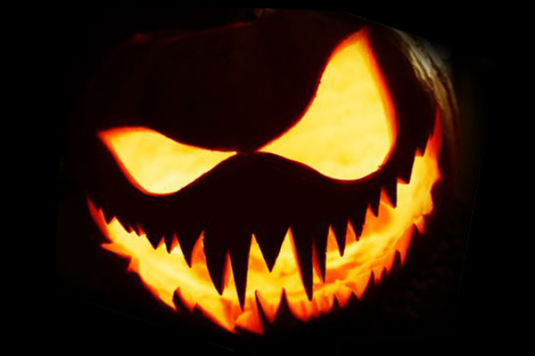
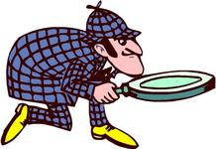
FUNWORK HOMEWORK!
Just follow the Plot Structure & Create!
Begin Brainstorming your own Plot Story!
Use the provided handout
You can write about anything and everything!
Love Story
Action/Adventure
Horror Story
Mystery Story

Slide 6
How is each level of our Plot Structure essential to making a successful story?

Slide 7
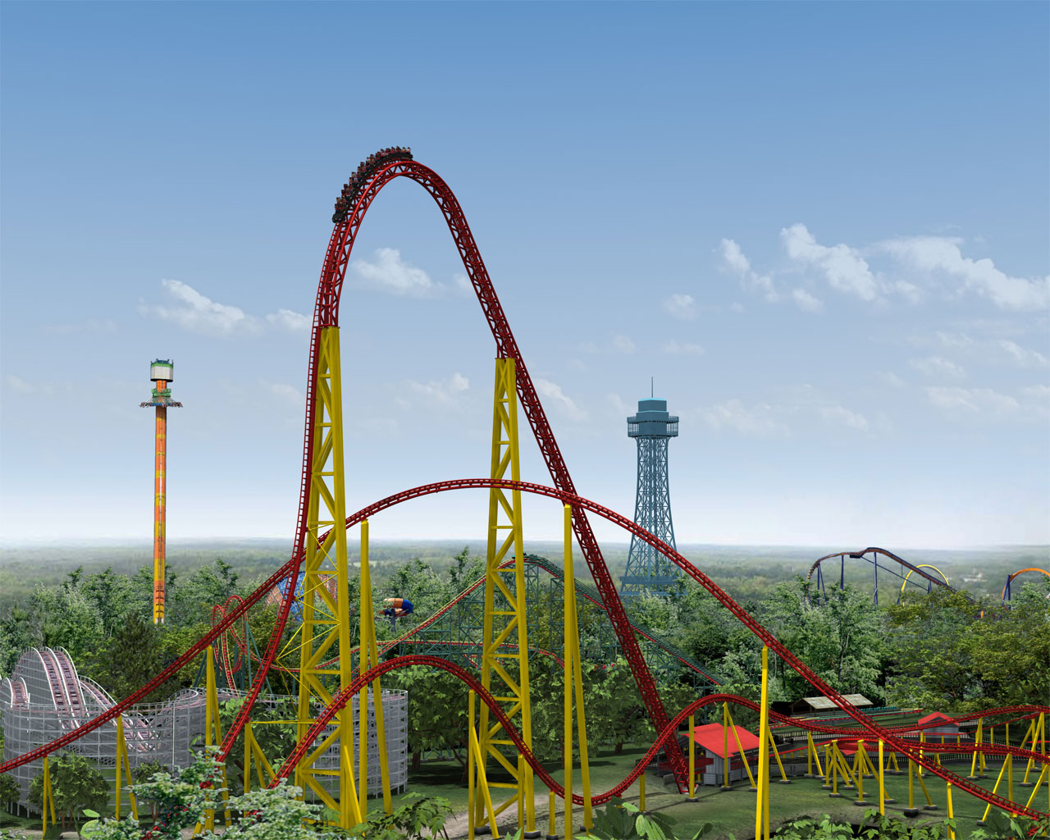
Every Story is like a Roller coaster!!
It has it’s ups and downs.
Enjoy the ride.
://www.youtube.com/watch?v=a5GZ1QOYdpk

Slide 8
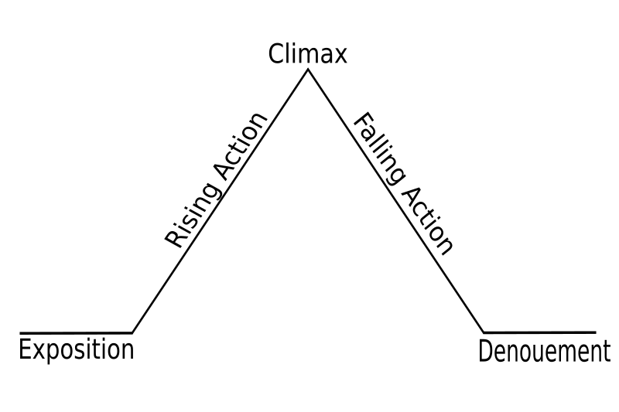
The Plot = Story
Resolution

Slide 9
Plot (definition)
Plot is the organized pattern or sequence of events that make up a story. Every plot is made up of a series of incidents that are related to one another.

Slide 10
1. Exposition
This usually occurs at the beginning of a short story. Here the characters are introduced. We also learn about the setting of the story. Most importantly, we are introduced to the main conflict (main problem).

Slide 11
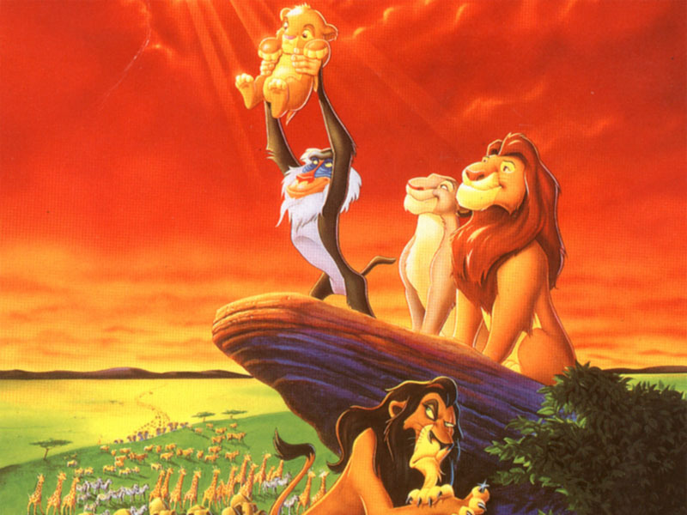
Plot structure: Exposition
  Sets the scene
  Author introduces the setting and characters
  Provides description and background information

Slide 12
2. Rising Action
This part of the story begins to develop the conflict(s). A building of interest or suspense occurs.

Slide 13
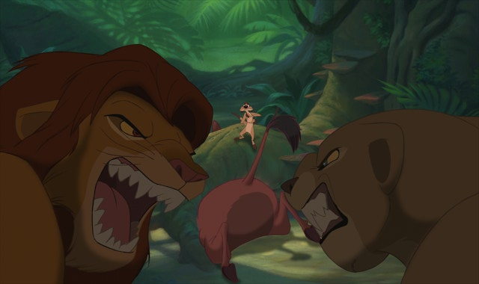
Plot structure: Rising action
Example
  Series of conflicts and crises in the story that lead to the turning point

Slide 14
3. Climax
This is the turning point of the story. Usually the main character comes face to face with a conflict. The main character will change in some way.

Slide 15
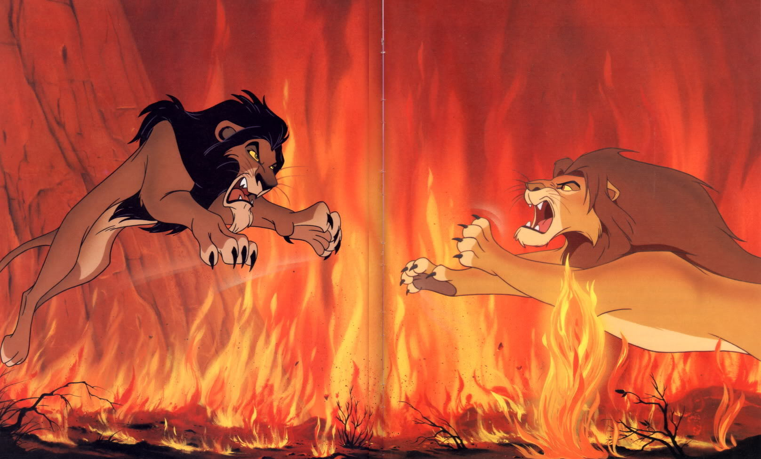
Plot structure: climax
Example
  Also called the “turning point”
  Event that the rising action and central conflict leads up to
  Place where plot turns or “changes direction” toward a resolution

Slide 16
4. Falling Action
All loose ends of the plot are tied up. The conflict(s) and climax are taken care of.

Slide 17
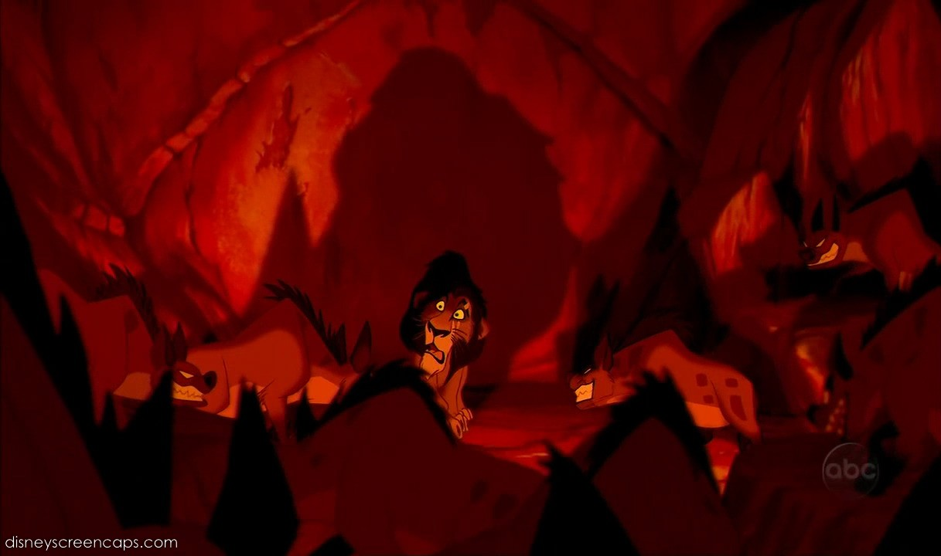
Plot structure: Falling Action
  Events that happen as a result of the climax as the conflict grows closer to being resolved

Slide 18
5. Resolution
The story comes to a reasonable ending.

Slide 19
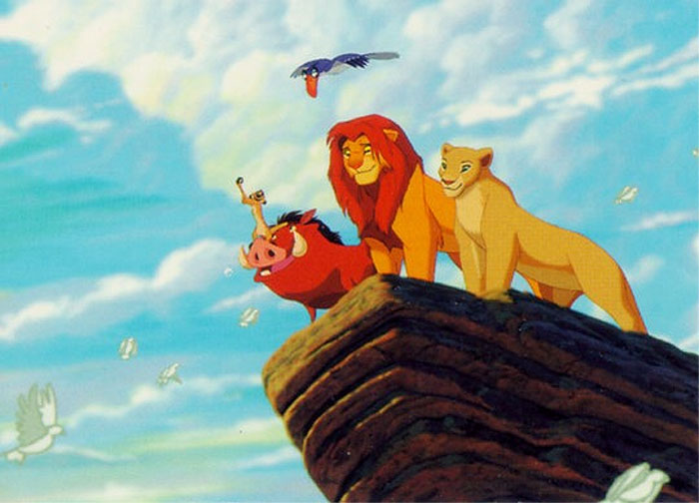
Plot structure: Resolution
  Main conflict is solved or resolved

Slide 20
Plot Diagram: Quiz
3
4
2
1
5

Slide 21
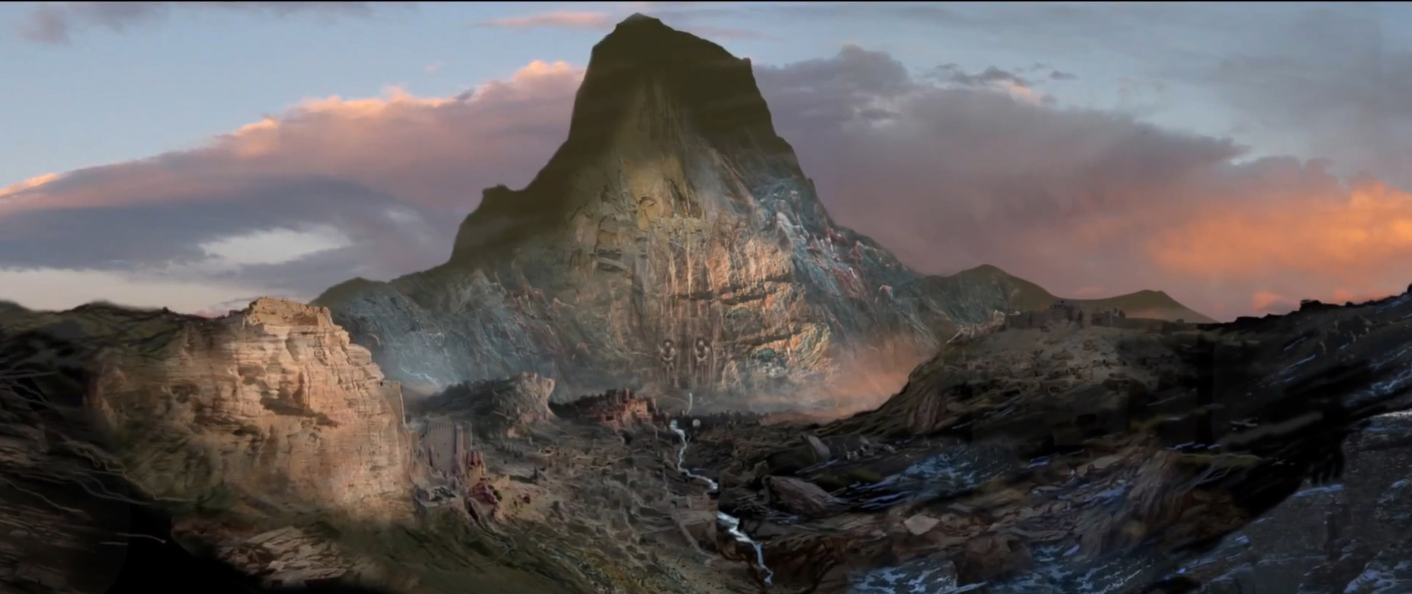
Climax:
The point of greatest dramatic tension or transition in a theatrical work.
Falling Action: The action following the climax of the work that moves it towards its denouement or resolution.
Rising Action: The part of a plot consisting of complications and discoveries that create conflict.
Exposition: Detailed information revealing the facts of a plot.
RESOLUTION: The final resolution of the conflict in a plot.

Slide 22
DO NOW DO NOW DO NOW
What causes great conflict?
Think of conflict in your life and the lives of others
Write a few of the reasons why there is conflict or the types of conflict that you think are the most common.

Slide 23
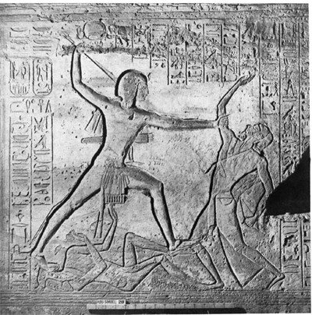
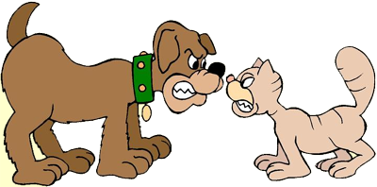
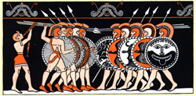
Plot: Conflict
Conflict is the dramatic struggle between two forces in a story. Without conflict, there is no plot.

Slide 24
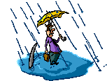

Plot: Types of Conflict
Character vs Character
Character vs Nature
Character vs Society
Character vs Self

Slide 25
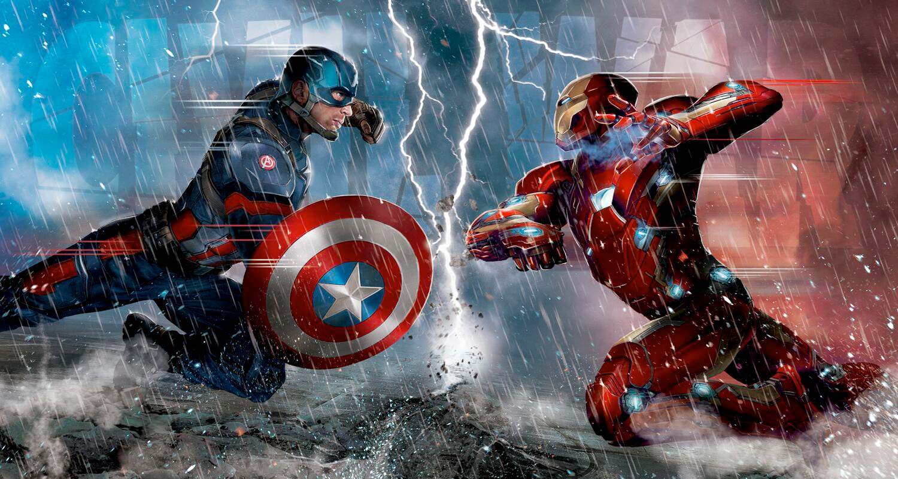
Character vs. Character
The main character is in conflict with another character, human or not human.

Slide 26
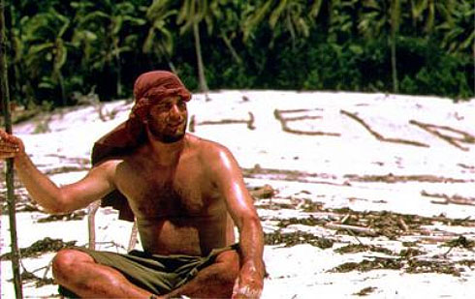
Plot: Character vs. Nature Conflict
The main character is in conflict with the forces of nature, which serve as the antagonist.

Slide 27
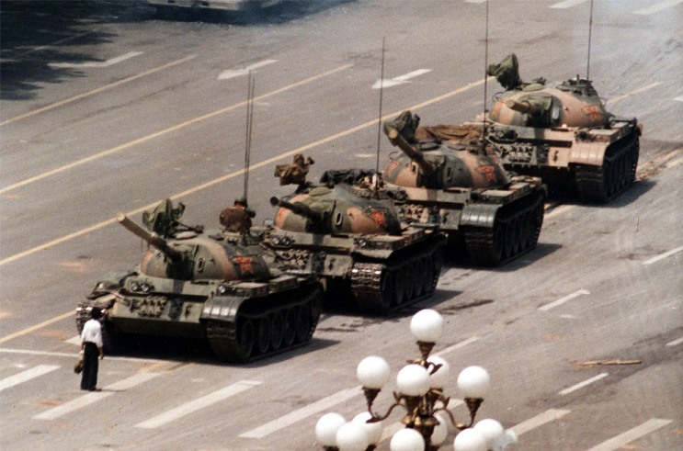
Plot: Character vs. Society Conflict
The main character in conflict with a larger group: a community, society, culture, etc.

Slide 28
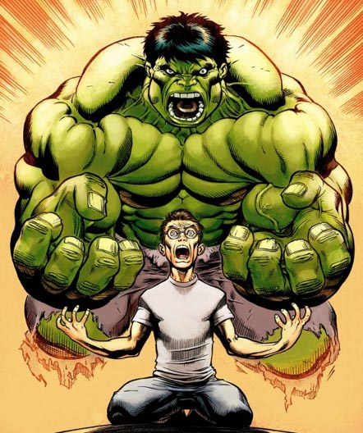
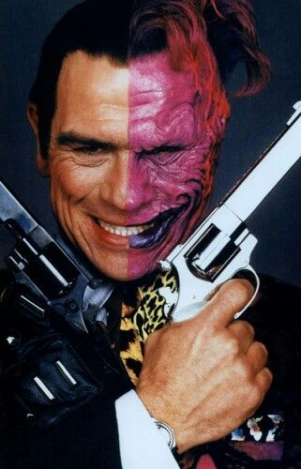
Plot: Character vs. Self Conflict
The main character experiences some kind of inner conflict.

Slide 29
3.
PLOT
Title:_____________________
Author:___________________
2._________
4.
5.
1._________________
Setting:
Situation:
Characters:
THEME:

Slide 30
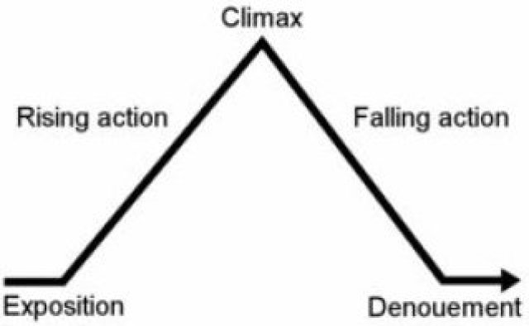
30 Second Plot Plays
Group up with your Role Partners!
Use your Reader’s Theater Scripts
Discuss & Write down the plot points on your Whiteboard (teacher example)
Perform a 30 second Plot play.

Slide 31
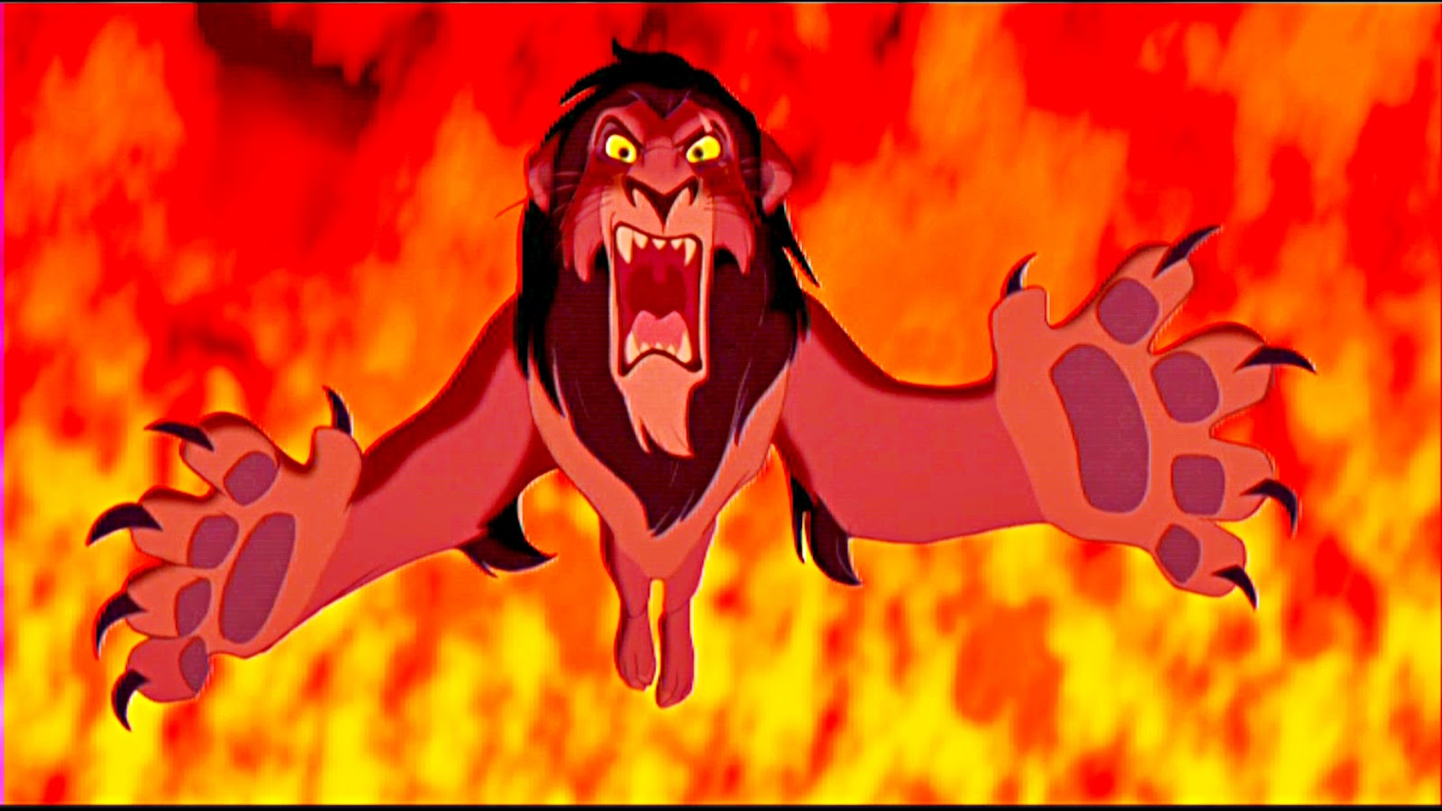
Antagonist : The Bad Guy

Slide 32
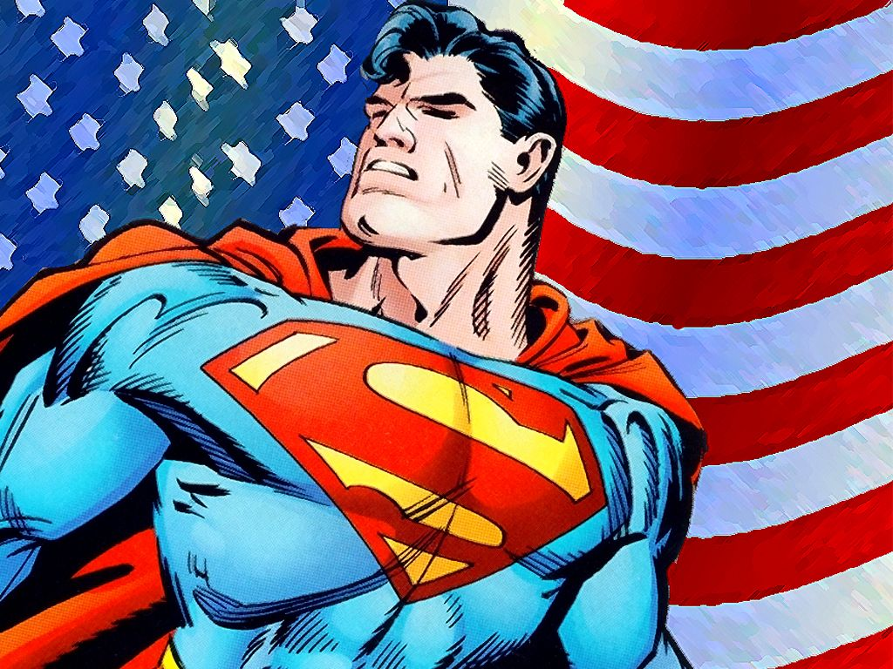
Protagonist : The Hero

Slide 33
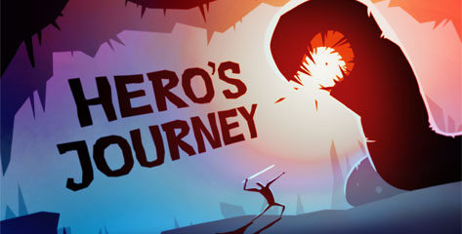
https://www.youtube.com/watch?v=Hhk4N9A0oCA

Slide 34
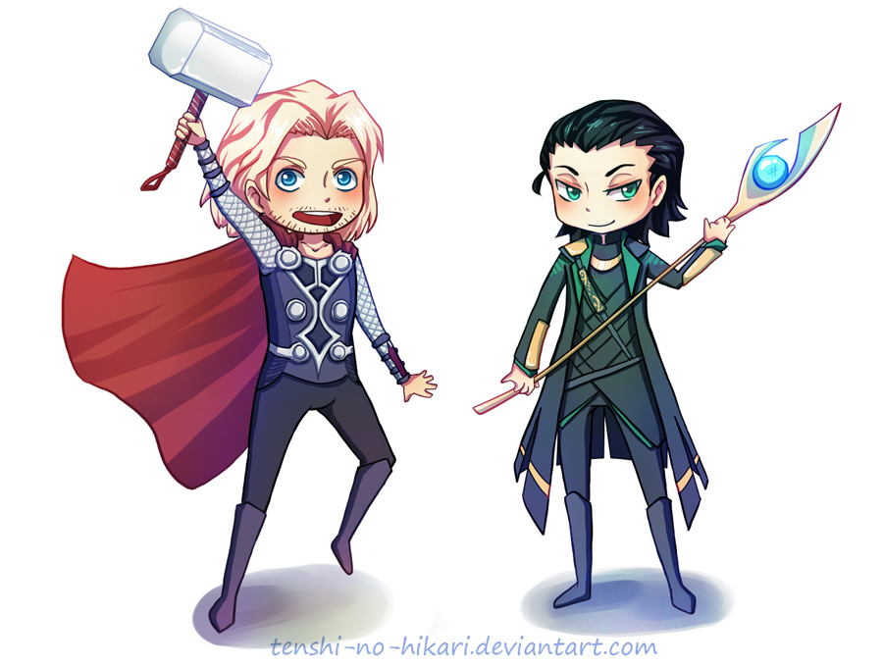
Loki and the Magic Hammer
Can you identify and describe our PLOT POINTS?

Slide 35
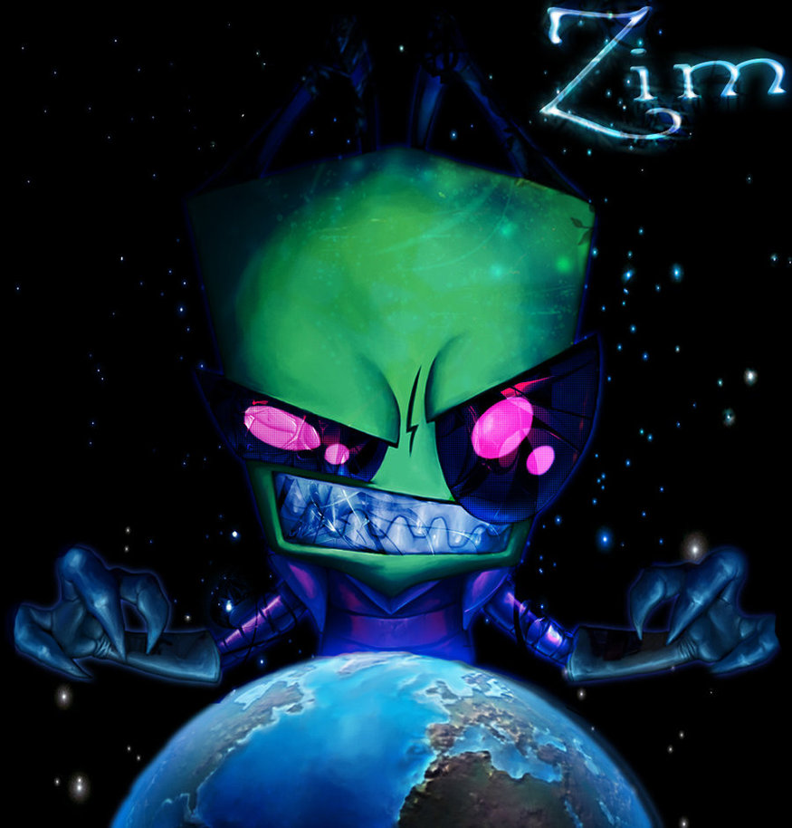
How would take over the world?
October 7th, 2013
Do Now! Do Now!

